Slide 1

Programming Test Problems

Slide 2
Outline
Newton-Raphson Method
Lagrange Interpolating Polynomial

Slide 3
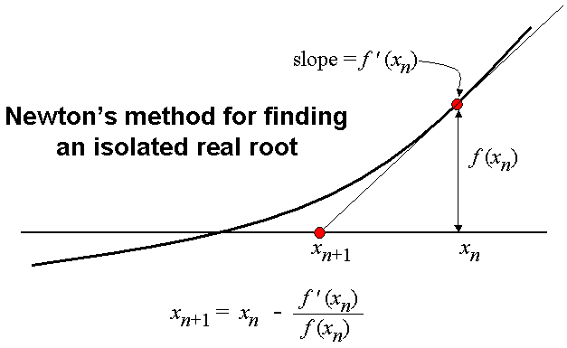




Newton-Raphson Method
Finding successively better approximations to the roots/zeroes of a real-valued function
Given:
  function ƒ defined over the reals x
  derivative ƒ‘
Begin first guess x₀ for a root of the function f
A better approximation x₁ is
(x₁, 0) is the intersection with the x-axis of the tangent to the graph of f at (x₀, f (x₀))
The process is repeated as
Until accurate value is reached |x_{n+1} – x_{n}| < ε
$$x:f(x)=0$$
$$x_{1}=x_{0}−\frac{\left.f(x_{0}\right)}{\left.f′(x_{0}\right)}$$
$$x_{n+1}=x_{n}−\frac{\left.f(x_{n}\right)}{\left.f′(x_{n}\right)}$$
Wolfram Demonstrations Project
The Newton-Raphson Method

Slide 4
Newton-Rhapson Method
Main program
Evaluated functions

Slide 5
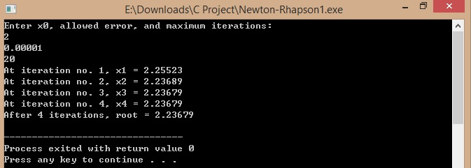
Newton-Rhapson Method

Slide 6

Newton-Rhapson Method
Test problems
f₁(x) = x^{2.3} – 6.37 = 0
f₂(x) = sin x – 0.5x = 0
Termination criterion |x_{n+1} – x_{n}| < ε, say ε = 10⁻⁶
x₀ = {0.8, 1, 1.2, 7}
Wolfram Demonstrations Project
The Newton-Raphson Method
Dev-C++
f₁(x)
f₂(x)

Slide 7
Reference Websites
Newton-Raphson Method
http://bit.ly/1s4whrh

Slide 8
Lagrange Interpolating Polynomial
Start with a set of n+1 points with different x-coordinates
(x₀, y₀), (x₁, y₁), (x₂, y₂),....,(x_{n}, y_{n})
Find a polynomial function that passes through all n+1 points
Interpolating polynomial

Slide 9




Lagrange Interpolating Polynomial
$$f(x)=a_{0}+a_{1}x+a_{2}x^{2}+...+a_{n}x^{n}$$
Polynomial:
General formula:
Lagrange basis polynomials:
Expand:
$$f(x)=\sum_{i=1}^{n+1}{L_{i}(x)y_{i}}$$
$$L_{i}(x)=\prod_{\begin{matrix}j=1 \\ i≠j\end{matrix}}^{n+1}{\frac{x−x_{j}}{x_{i}−x_{j}}}$$
$$L_{i}(x)=\prod_{\begin{matrix}j=1 \\ i≠j\end{matrix}}^{n+1}{\frac{x−x_{j}}{x_{i}−x_{j}}}=\frac{x−x_{0}}{x_{1}−x_{0}}...\frac{x−x_{i−1}}{x_{i}−x_{i−1}}.\frac{x−x_{i+1}}{x_{i}−x_{i+1}}...\frac{x−x_{n+1}}{x_{i}−x_{n+1}}$$

Slide 10
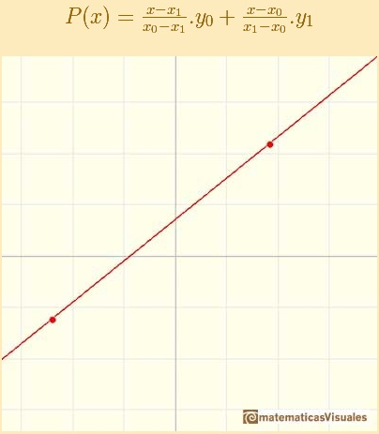
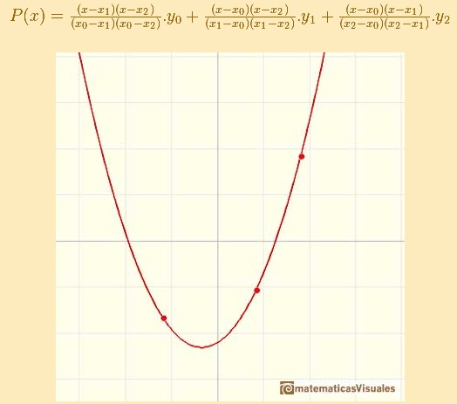
Lagrange Interpolating Polynomial

Slide 11
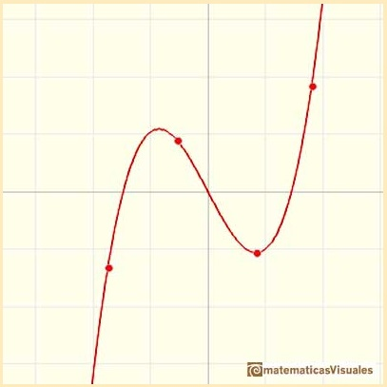
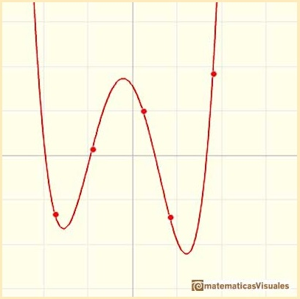
Lagrange Interpolating Polynomial

Slide 12
Lagrange Interpolating Polynomial
x | y
0.1 | 1.20998
0.3 | 1.68847
0.45 | 2.09434
0.62 | 2.59304
0.75 | 2.96104
0.86 | 3.33271
0.91 | 3.48612
0.93 | 3.54692
1.15 | 4.17276
1.30 | 4.51711
Determine the values of y with Lagrange interpolation when
x = {0.2, 0.4, 0.6, 0.8, 1.0, 1.2}
Compare interpolated values with exact values according to
y = e^{x} (cos x + sin x)

Slide 13
Lagrange Interpolating Polynomial
Lagrange Interpolating Polynomial

Slide 14



Lagrange Interpolating Polynomial
For any arbitrary n+1 data points [x_{i} ,y_{i}]
Evaluated at x_{eval}
Step 1: Let f = 0
Step 2: For i = 1 to n+1 do steps 3 to 6
Step 3: Let s = 1
Step 4: For j = 1 to n+1 do step 5
Step 5: if i and j are not equal then let
Step 6:
Step 7: End
$$\begin{matrix}f(x_{eval})=\sum_{i=1}^{n+1}{L_{i}(x_{eval})y_{i}} \\ L_{i}(x_{eval})=\prod_{\begin{matrix}j=1 \\ i≠j\end{matrix}}^{n+1}{\frac{x_{eval}−x_{j}}{x_{i}−x_{j}}}\end{matrix}$$
$$s=s\frac{x_{eval}−x_{j}}{x_{i}−x_{j}}$$
$$f(x_{eval})=f(x_{eval})+s×y_{i}$$

Slide 15
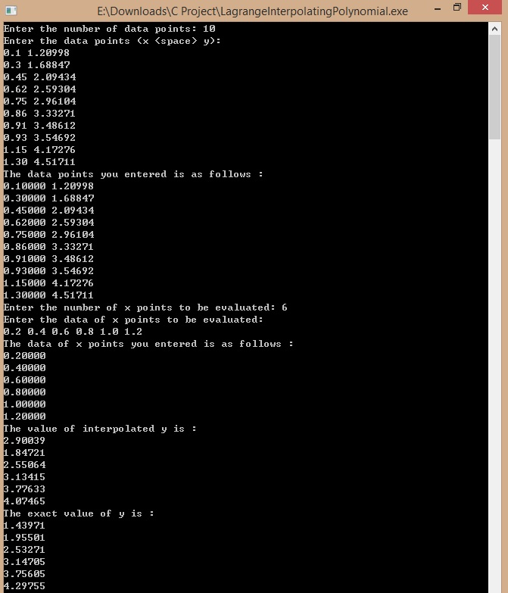
Lagrange Interpolating Polynomial

Slide 16
Lagrange Interpolating Polynomial

Slide 17
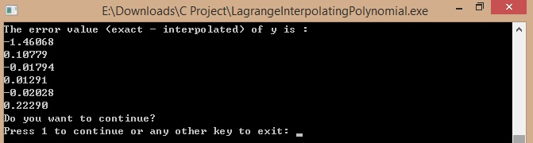
Lagrange Interpolating Polynomial
Wolfram Demonstrations Project
Lagrange Interpolating Polynomial
Dev-C++
Lagrange Interpolating Polynomial

Slide 18
Lagrange Interpolating Polynomials
Input data points

Slide 19
Lagrange Interpolating Polynomials
Input evaluated data points

Slide 20
Lagrange Interpolating Polynomials
Main program & evaluated output

Slide 21
Lagrange Interpolating Polynomials
Exact and error output

Slide 22
Reference Websites
Newton-Raphson Method
http://bit.ly/1s4whrh
Interpolating Polynomial
http://bit.ly/1CYd4Me
http://bit.ly/12XDGxc
Lagrange Interpolating Polynomial with Exact Functions
http://bit.ly/1vEVS9M

